Slide 1
The Veteran Dataset
Statistical Analysis of Reliability and Survival Data
Antoine Chen
Charlotte Vercammen
Sander Van Wayenbergh

Slide 2
Table of contents
Part A: Descriptive analysis
Part B: Non-parametric survival model
Part C: Semi-parametric and parametric survival model
Extra analysis: Clustering
Conclusion

Slide 3
Part A: Descriptive analysis

Slide 4
Introduction
US Veterans Administration → male patients with advanced lung cancer
Variables:
treatment
cell type
survival time
censoring status
Karnofsky performance score
time from diagnosis to randomisation in months
age of the patients in years
prior therapy

Slide 5
Descriptive analysis
 | trt | time | status | karno | diagtime | age | prior
Min. | 1.00 | 1 | 0.00 | 10 | 1 | 34 | 0
1st Qu. | 1.00 | 25 | 1.00 | 40 | 3 | 51 | 0
Median | 1.00 | 80 | 1.00 | 60 | 5 | 62 | 0
Mean | 1.50 | 121.6 | 0.93 | 58.57 | 8.77 | 58.31 | 2.92
3rd Qu. | 2.00 | 144 | 1.00 | 75 | 11 | 66 | 10
Max. | 2.00 | 999 | 1.00 | 99 | 87 | 81 | 10

Slide 6
Censoring status, treatment and cell type
Censoring status |  | Treatment |  | Cell type
0 | 1 | 1 | 2 | Squamous | Small cell | Adeno | Large
9 | 128 | 69 | 68 | 35 | 48 | 27 | 27

Slide 7
Part B: Non-parametric survival model

Slide 8
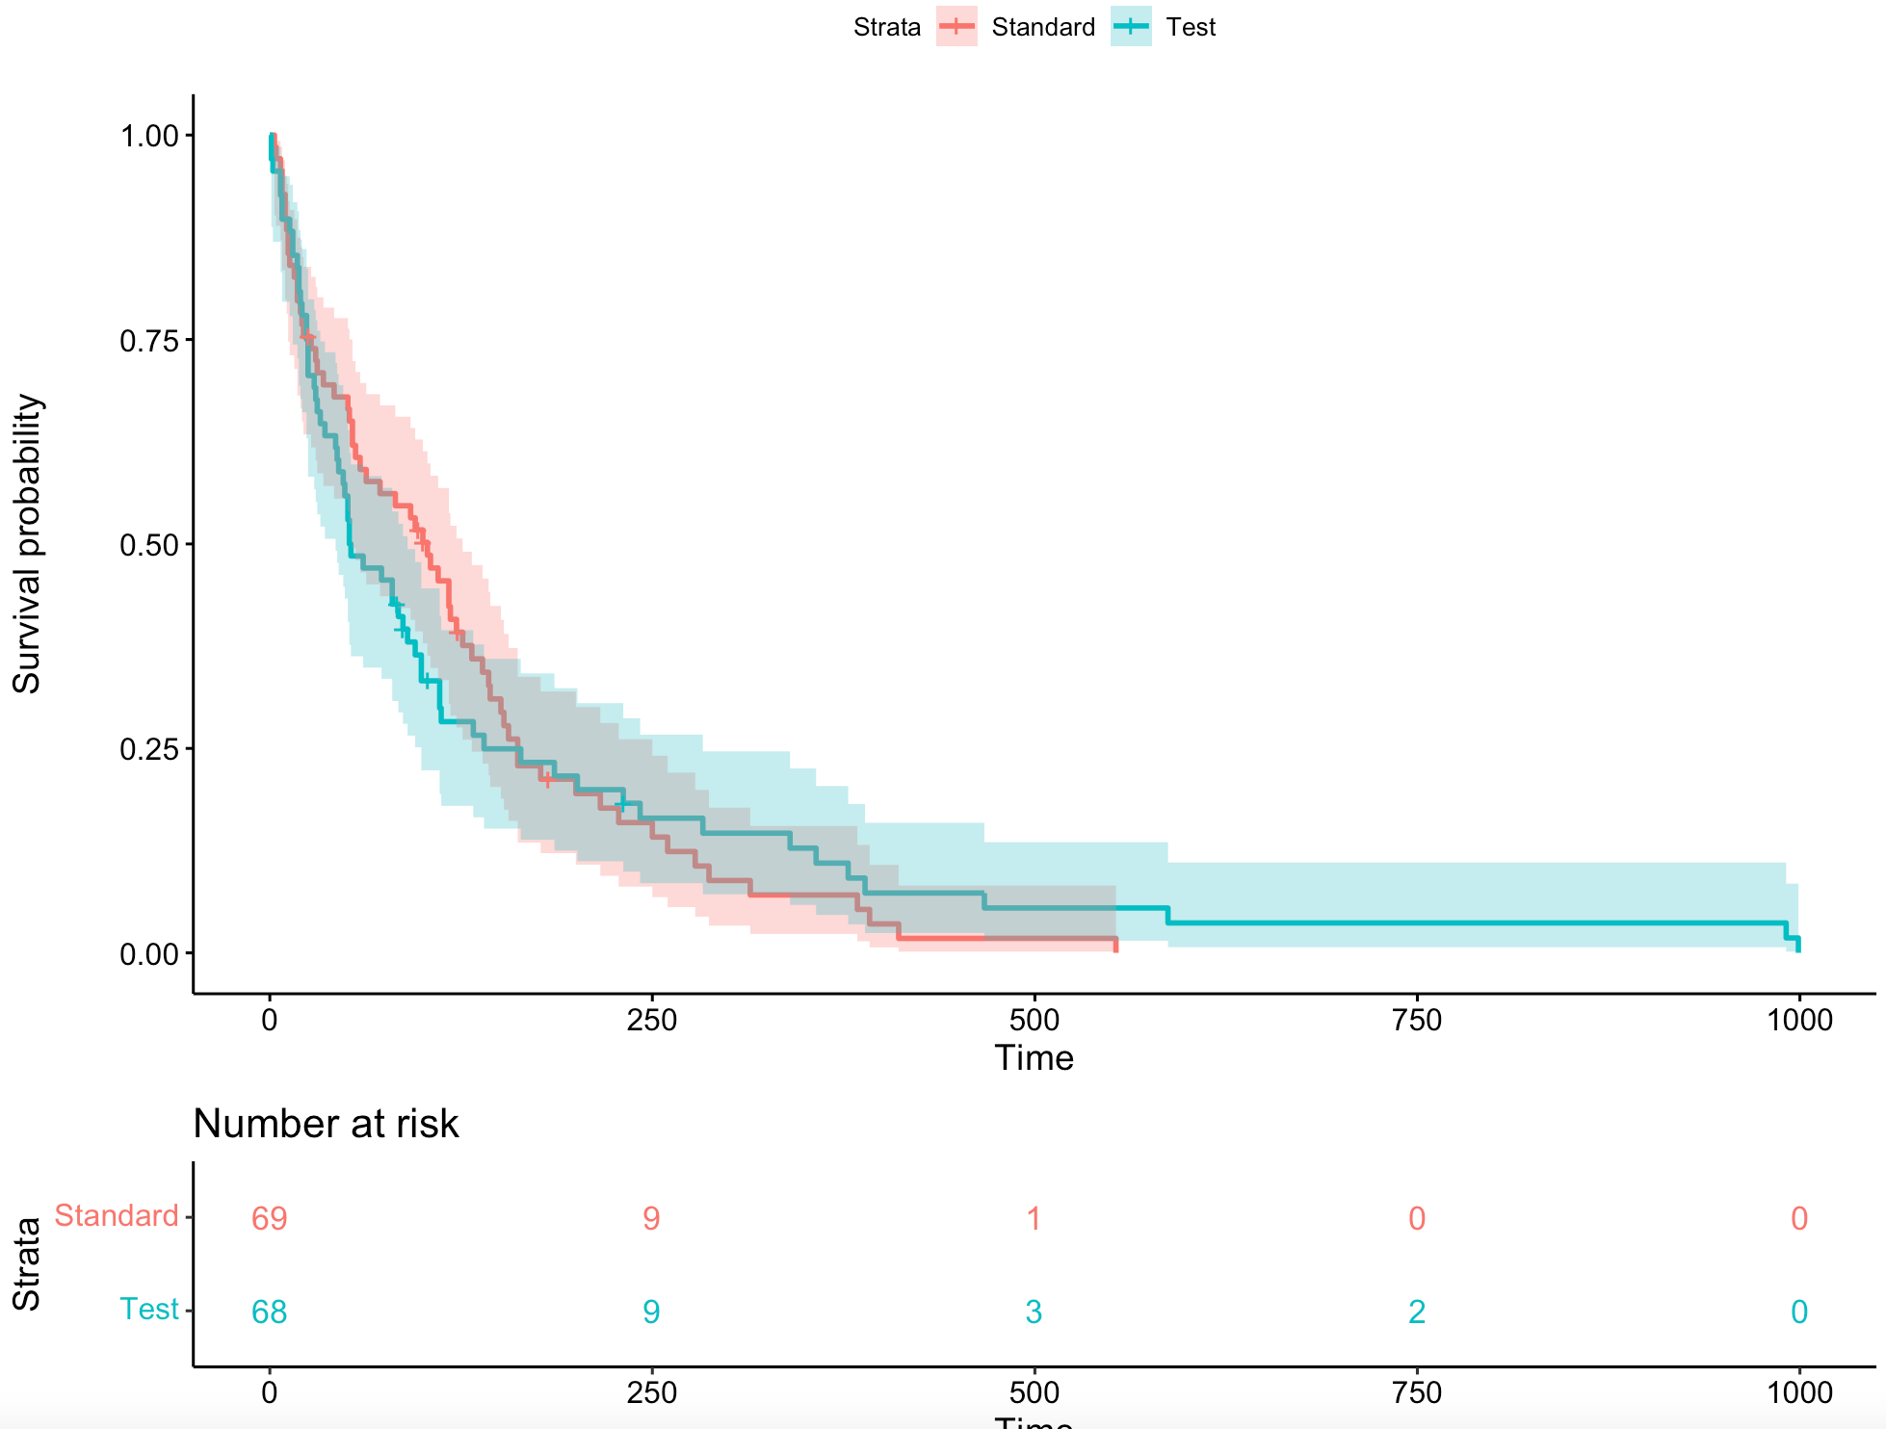
Survival distribution: Treatment

Slide 9
b) Kaplan-Meier estimator: Treatment
Trt | n | events | 1st quartile (75%) | 2nd quartile (median) | 3th quartile (25%)
Standard | 69 | 64 | 27; 95%CI[12,54] | 103; 95%CI[54,126] | 162; 95%CI[132,250]
Test | 68 | 64 | 25; 95%CI[15,33] | 53; 95%CI[43,90] | 140; 95%CI[99,283]

Slide 10
c) Log-rank test: Treatment
Trt | n | Observed | Expected | (0-E)^2/E | (0-E)^2/V
Standard | 69.0 | 64.0 | 64.5 | 0.00388 | 0.00823
Test | 68.0 | 64.0 | 63.5 | 0.00394 | 0.00823
Chisq= 0 on 1 degrees of freedom, p= 0.93

Slide 11
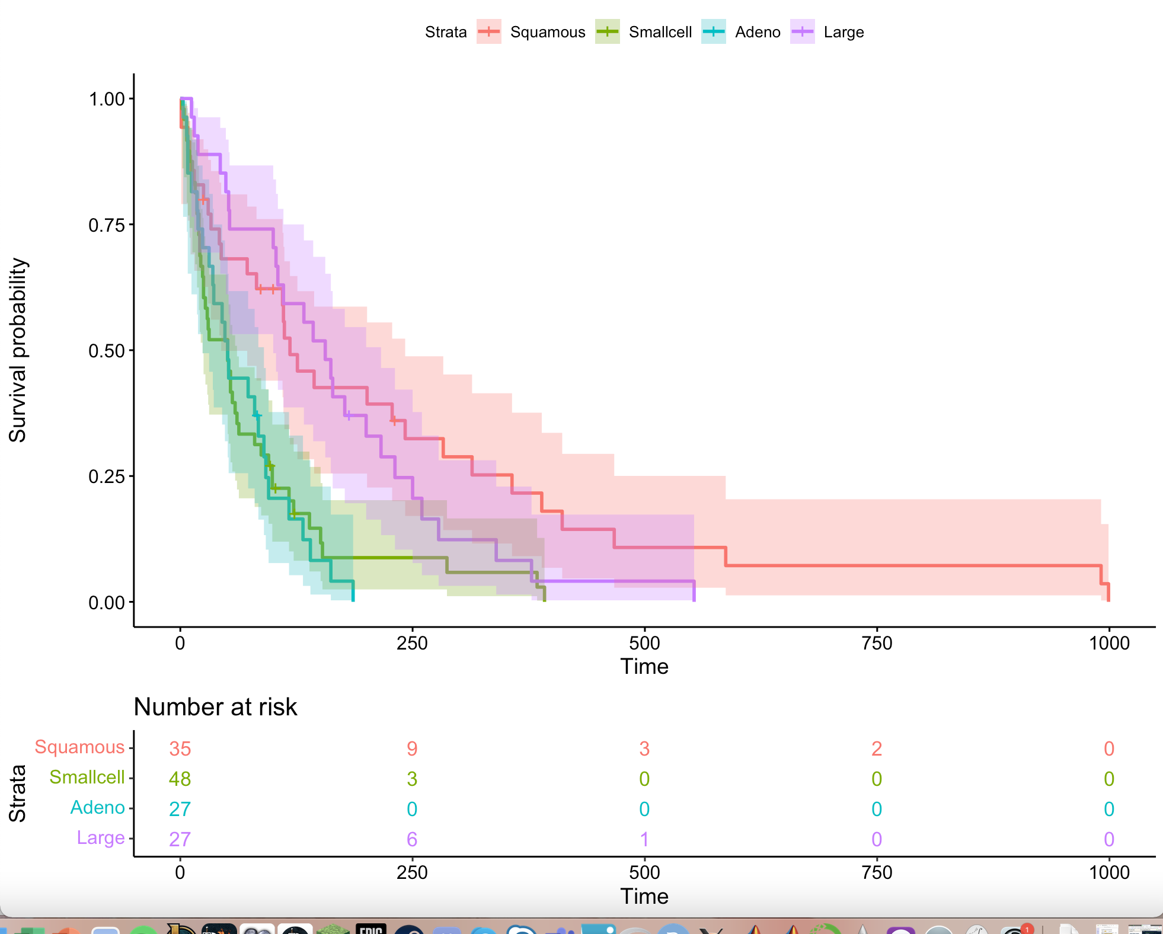
Survival distribution: Cell type

Slide 12
b) Kaplan-Meier estimator: Cell type
Celltype | n | events | 1st quartile (75%) | 2nd quartile (median) | 3th quartile (25%)
Squamous | 35 | 31 | 33; 95%CI[10,110] | 118; 95%CI[44,242] | 347; 95%CI[201,587]
Smallcell | 48 | 45 | 20; 95%CI[10,25] | 51; 95%CI[24,61] | 99; 95%CI[59,151]
Adeno | 27 | 26 | 19; 95%CI[7,36] | 51; 95%CI[25,90] | 92; 95%CI[73,140]
Large | 27 | 26 | 53; 95%CI[15,111] | 156; 95%CI[100,216] | 231; 95%CI[164,340]

Slide 13
c) Log-rank test: Cell type
Celltype | n | Observed | Expected | (0-E)^2/E | (0-E)^2/V
Squamous | 35.0 | 31.0 | 47.7 | 5.82 | 10.53
Smallcell | 48.0 | 45.0 | 30.1 | 7.37 | 10.20
Adeno | 27.0 | 26.0 | 15.7 | 6.77 | 8.19
Large | 27.0 | 26.0 | 34.5 | 2.12 | 3.02
Chisq= 25.4 on 3 degrees of freedom, p= 1e-05

Slide 14
Part C: Semi-parametric and parametric survival model

Slide 15
a) Semi-parametric: Cox proportional hazard model
- h_{i}(t) = h₀(t) exp(β^{t}x_{i})
Covariate | β | s.e.(β) | HR | 95% CI
Celltype smallcell | 0.72 | 0.25 | 2.04 | [1.24,3.36]
Celltype adeno | 1.16 | 0.29 | 3.18 | [1.79,5.65]
Celltype large | 0.33 | 0.28 | 1.38 | [0.81,2.38]
Karnofsky score | -3.10 e-02 | 5.18e-03 | 0.97 | [0.96,0.98]

Slide 16
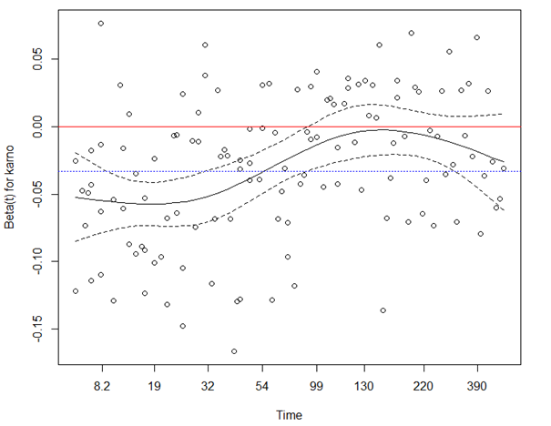
Validation of the proportional hazard assumption
Conclusion: The Karnofsky score variable is not constant over time

Slide 17
b) Parametric
Akaike information criterion (AIC)
Log-logistic | Exponential | Log-normal | Weibull
1437.19 | 1443.94 | 1444.32 | 1445.03
Conclusion: the log-logistic model is the best suited candidate model

Slide 18
Log-logistic: Estimation of the coefficients
coefficient | Log-logistic
 | Linear | AFT
Intercept (=squamous) | 2.48; 95%CI[1.82,3.14] | -2.48;95%CI[-1.82,-3.14]
small cell | -0.69; 95%CI[-1.17,-0.21] | 0.69; 95%CI[1.17,0.21]
adeno | -0.78; 95%CI[-1.3,-0.26] | 0.78; 95%CI[1.3,0.26]
large | -0.029; 95%CI[-0.55,0.49] | 0.029; 95%CI[0.55,-0.49]
karnofsky | 0.036; 95%CI[0.03,0.04] | -0.036; 95%CI[-0.03,-0.04]

Slide 19
Extra analysis: Clustering

Slide 20
Extra analysis: Clustering
 | Squamous | Smallcell | Adeno
Smallcell | 0.00134 | - | -
Adeno | 0.00134 | 0.75565 | -
Large | 0.43731 | 0.00331 | 0.00016
Level | Cluster
Squamous | 1
Smallcell | 2
Adeno | 2
Large | 1

Slide 21
Conclusion
Clusters of lung cancer cell types ranked by mortality risk:
Adenocarcinoma and small cell carcinoma
2) Large and squamous cell carcinoma

